Slide 1
An introduction to Reinforcement Learning
Daniel Renz, Translational Neuromodeling Unit, ETHZ & UZH
12.03.2015

Slide 2
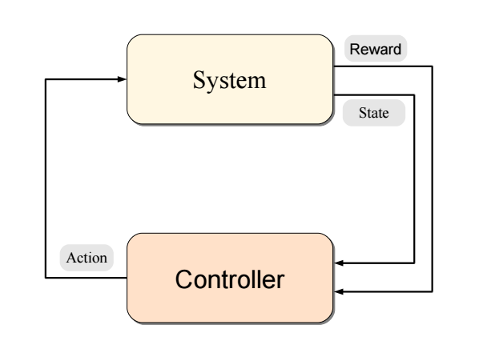
What is Reinforcement Learning (RL) ?
Reinforcement Learning = Sequential decision-theory = Adaptive control.
Learning by interaction: An agent learns through trial-and-error by interacting with an unfamiliar, stochastic environment.
This means that an RL agent combines learning, planning and execution into one phase.
Goal-directed learning: Learn to act such as to maximize expected long-term reward (return).
Often sparse rewards, unlike in supersived learning.

Slide 3
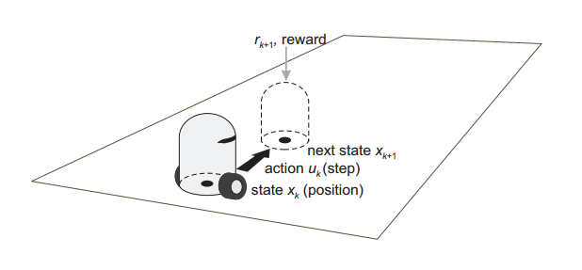
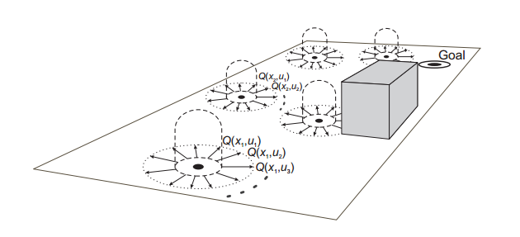
Example cleaning robot
The agent has access to a set of actions.
At each point in time, it occupies a certain state.
A reward results from a transition (s_{t}, a_{t}, s_{t+1}).
A policy π(s,a) = p(a|s) is essentially a decision function.
Solving the RL problem means finding the optimal policy w.r.t. expected return.
Notes:
RL combines learning, planning and execution into one phase.

Slide 4
Example cleaning robot
Actions: UP, DOWN, LEFT, RIGHT
Choosing UP results in
80% move UP
10% move LEFT
10% move RIGHT
Get reward of +1 in the lower right corner.
Get reward of -0.04 for each step.
How to get max reward?
Notes:
RL combines learning, planning and execution into one phase.

Slide 5
Example cleaning robot
Is this a valid solution?
Notes:
RL combines learning, planning and execution into one phase.

Slide 6
Example cleaning robot
Is this a valid solution? No, actions are stochastic.
Notes:
RL combines learning, planning and execution into one phase.

Slide 7
Example cleaning robot
Is this a valid solution? No, actions are stochastic.
Optimal solution.
Notes:
RL combines learning, planning and execution into one phase.

Slide 8
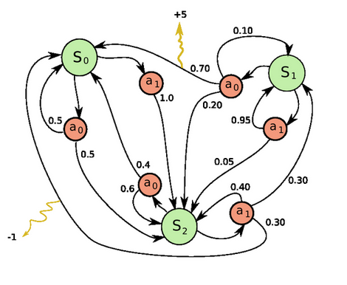
Markov Decision Process (MDP)
The interaction between agent and environment is formalized as a Markov Decision Process (MDP).
An MDP is a 4-tuple (S, A, T(s‘,a,s), R(s‘,a,s)). S, A are finite sets of states, actions.
Transitions, and thus policies are independent of the history (Markov assumption).
Learning is based on experience: (s, a, r, s‘).
If T and R are known, we have a classic optimal control problem. If they are unknown, we have a classic RL problem.
s
a
r
s’

Slide 9
Markov Decision Process (MDP)
An MDP is a 4-tuple (S, A, T(s‘,a,s), R(s‘,a)).
But in order to solve the RL problem, something is missing...

Slide 10
RL objective function
An MDP is a 4-tuple (S, A, T(s‘,a,s), R(s‘,a)).
But in order to solve the RL problem, something is missing...
...the objective function! Want to find the optimal policy π w.r.t. expected return:
We are interested in the expected discounted long-term return.
Effectively puts pressure on acting as soon as possible.
Discounting ensures that the return is bounded.

Slide 11
What is RL used for?
Planning problem: Solve a known MDP.
Prediction problem: Estimate a value function that represents how much future reward we can expect at any state, given a fixed policy.
Control problem: Optimise the value function. This yields an optimal policy which allows for action selection and optimal control.

Slide 12
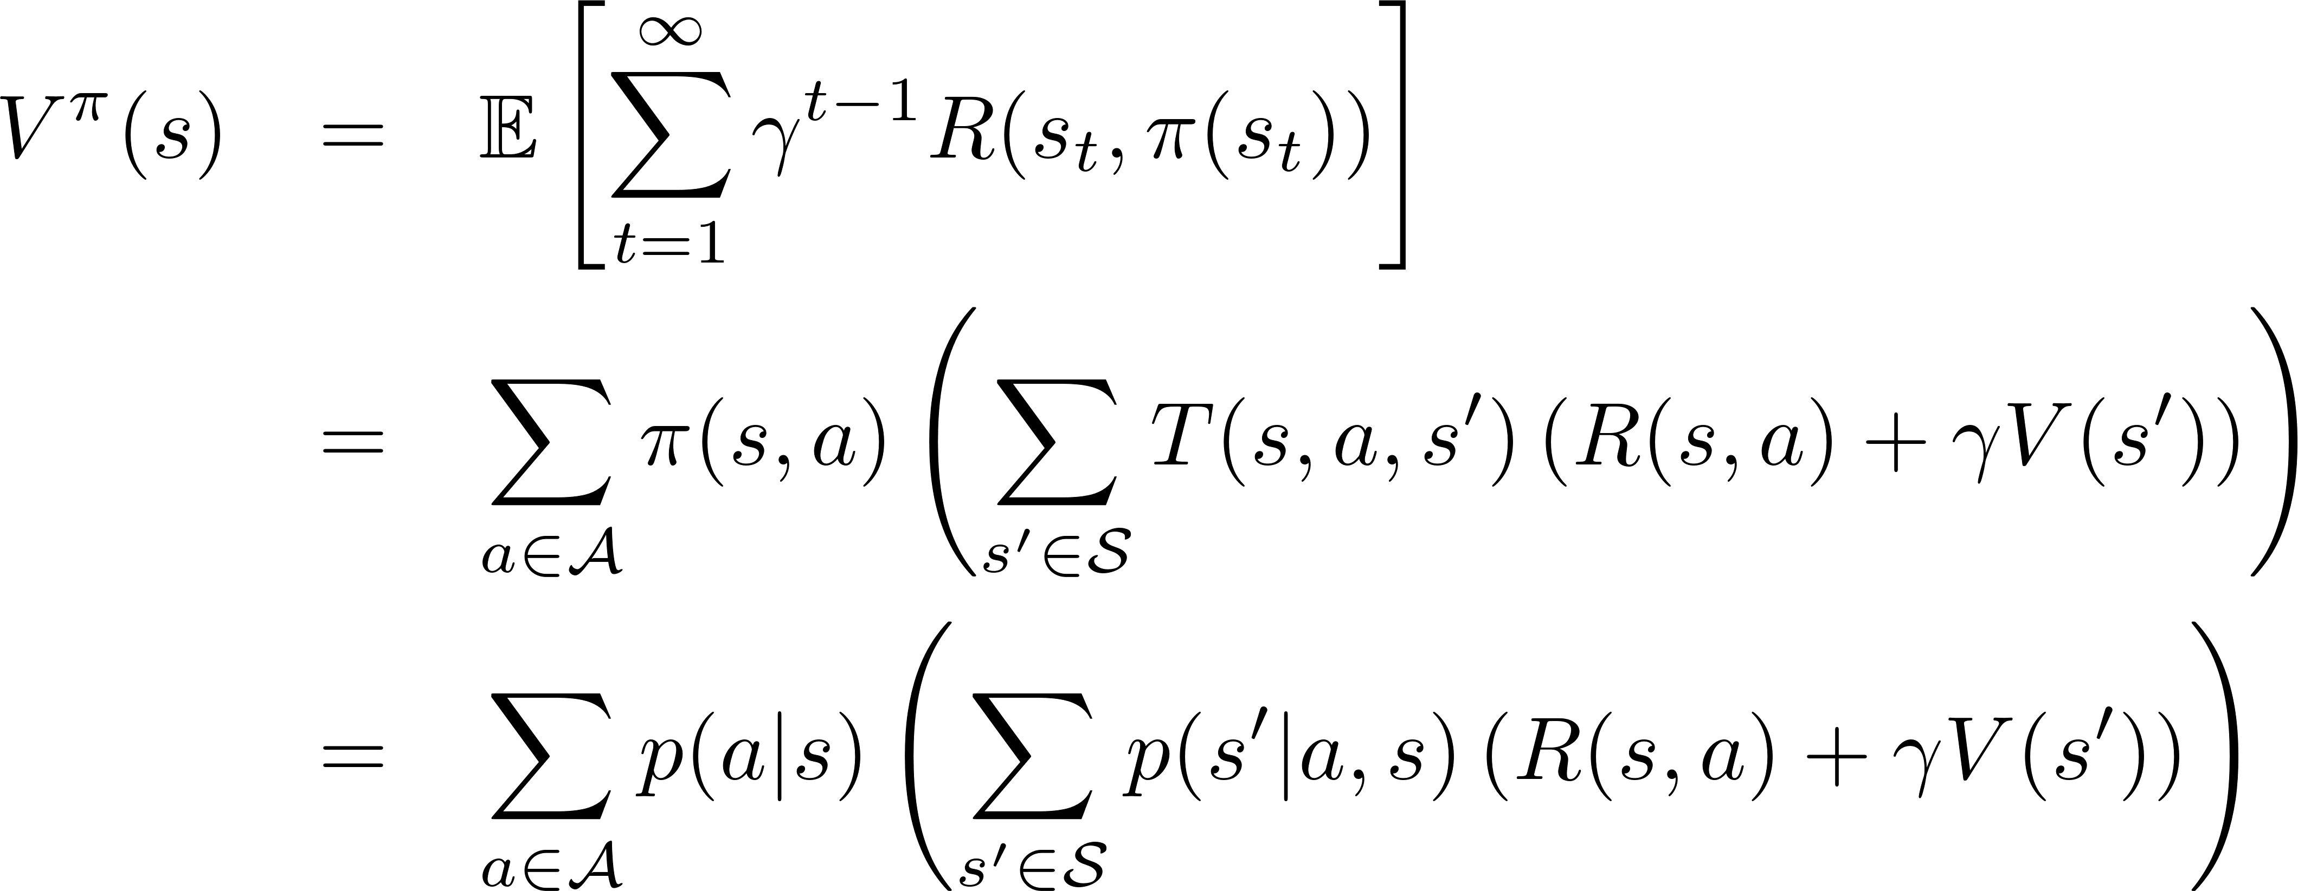
Bellman equations
Planning problem: Solve a known MDP.
Prediction problem: Estimate a value function that represents how much future reward we can expect at any state, given a fixed policy.
Control problem: Optimise the value function. This yields an optimal policy which allows for action selection and optimal control.
Bellman
equations
How to pick the best action given a known MDP?
Notes:
V: Expected return when starting in s and acting according to pi.
Note the sloppiness in notation. The output of pi(s) is an action, whereas the output of pi(s,a) is a probability.

Slide 13
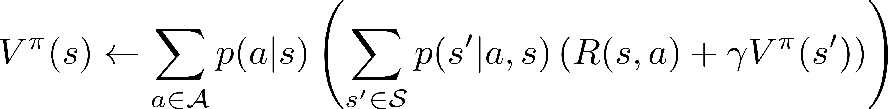
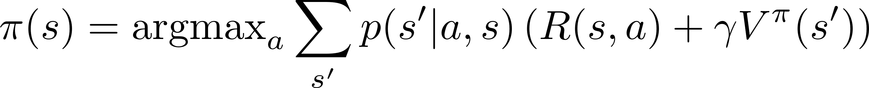
Planning: dynamic programming (DP)
Find the best policy π based on knowledge of transitions T and rewards R.
Idea
Initialize π arbitrarily
Repeat until convergence
Compute V^{π} from π (policy evaluation)
Improve π based on V^{π} (policy improvement)
Prediction
Control

Slide 14
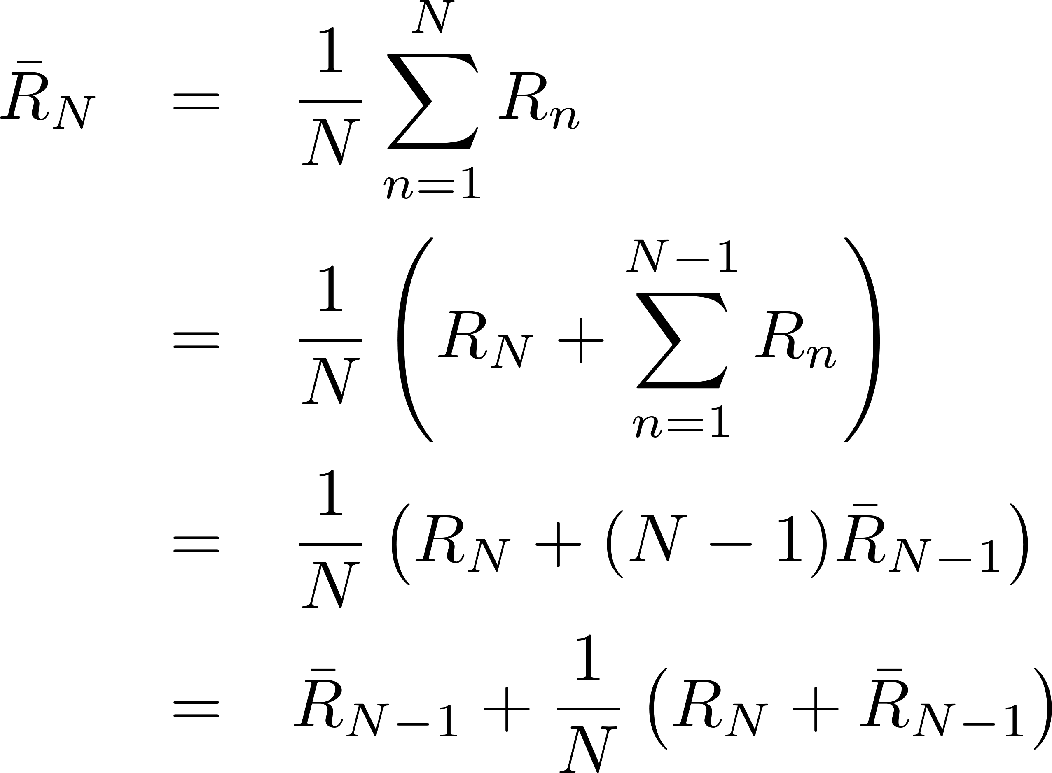
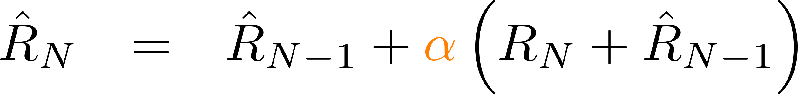
Prediction using Monte Carlo (MC) methods
Replace knowledge of T, R with experience, to approximate the policy evaluation step.
Idea: Estimate state value / expected return by averaging over sample returns iteratively (this implements a running average).
Repeat until convergence
Generate episode N given π
For each state s occuring in episode: Set R_{N} to the return following the first occurance of s and update moving average
Using a fixed alpha corresponds to an exponential moving average. This makes recent samples more important and forgets the distant past.

Slide 15
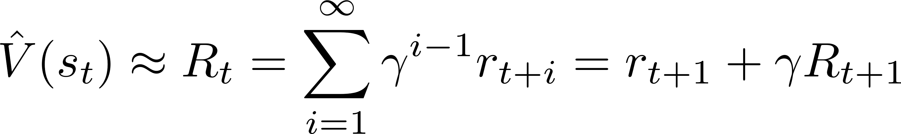
Prediction: Temporal difference (TD) Learning
Combination of ideas from Monte Carlo and Dynamic Programming
Model-free: Sample the environment according to policy (MC)
Bootstrap: approximate current estimate based on previously learned estimates (DP). Thus, we can update at every step.
Need to approximate R_{t} ...

Slide 16
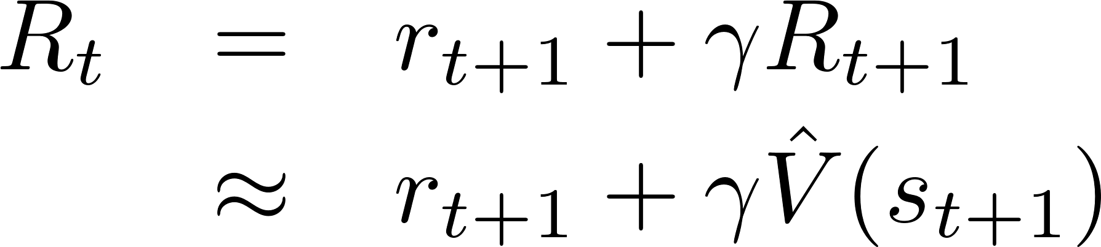
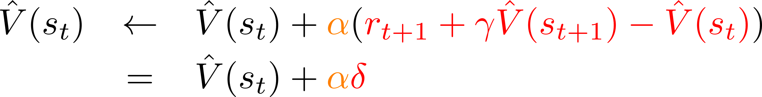
Prediction: Temporal difference (TD) Learning
We essentially assume that the value of the next state is an accurate estimate of the expected return downstream.
No need to know T, R. We use the frequencies of observations as estimates to directly update V.

Slide 17
Prediction: Temporal difference (TD) Learning
We essentially assume that the value of the next state is an accurate estimate of the expected return downstream.
No need to know T, R. We use the frequencies of observations as estimates to directly update V.
Great idea! But we really want to solve the control problem.

Slide 18
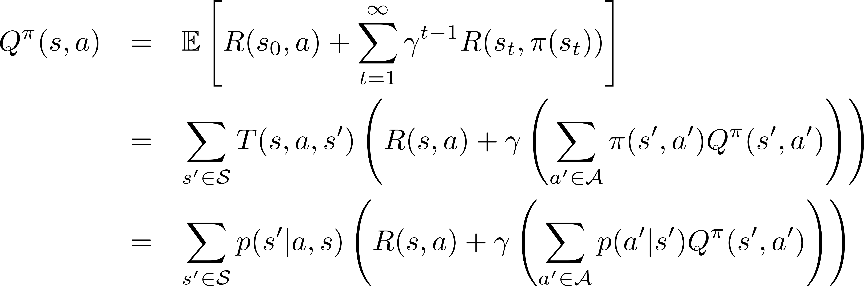
Bellman equations
Planning problem: Solve a known MDP.
Prediction problem: Estimate a value function that represents how much future reward we can expect at any state, given a fixed policy.
Control problem: Optimise the value function. This yields an optimal policy which allows for action selection and optimal control.
Bellman
equations
Notes:
V: Expected return when starting in s and acting according to pi
Q: Expected return when starting in s, taking action a, and then acting according to pi

Slide 19
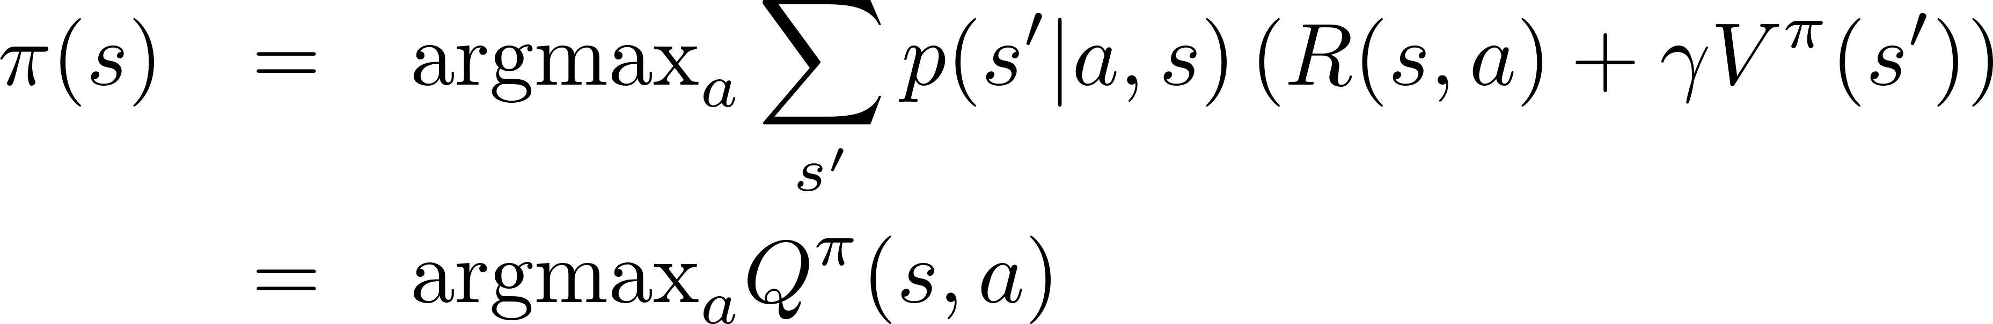
Control with Q-Learning
Q-values make control-life really simple.
When updating Q-values, we assume the agent acts greedily.

Slide 20
Control with Q-Learning
Repeat until convergence:
Choose action according to some policy.
Update Q-values assuming that the agent is acting greedily.
This is amazing: It is guaranteed to converge independent of the policy (as long as every state is reachable).
It does not solve the exploration vs. exploitation issue (which policy should we use to efficiently learn the Q-values?).
Want to choose a policy that appears to maximize Q most of the time, but choose some other action the rest of the time.
Nice demo: http://blog.allanbishop.com/q-learning/

Slide 21
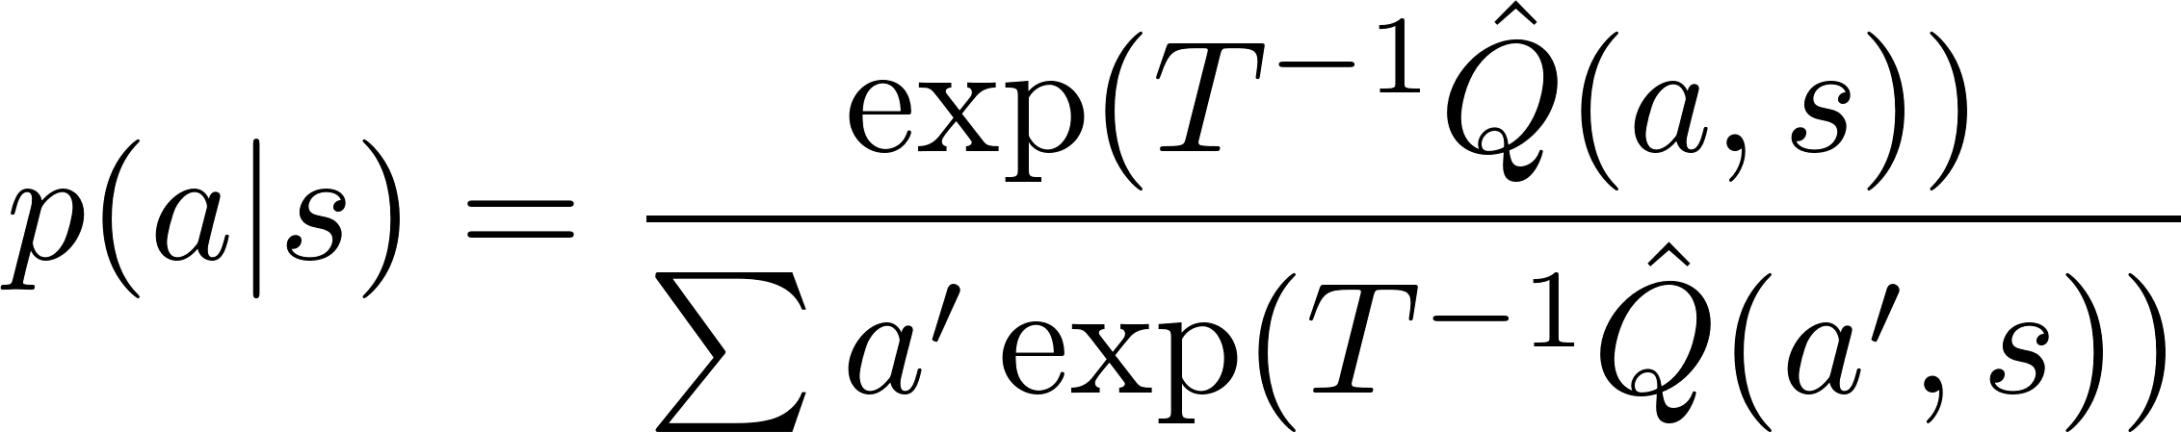
Which policy to use?
Choosing the right policy can greatly influence convergence speed.
Greedy: Always exploit. Not very useful.
ε-greedy: With probability ε choose uniformly from non-optimal actions.
Softmax: Choose actions according to their values. If the temperature T is large, all actions are approximately equally probable.
Optimistic exploration: Preferably choose actions that have been undersampled.

Slide 22
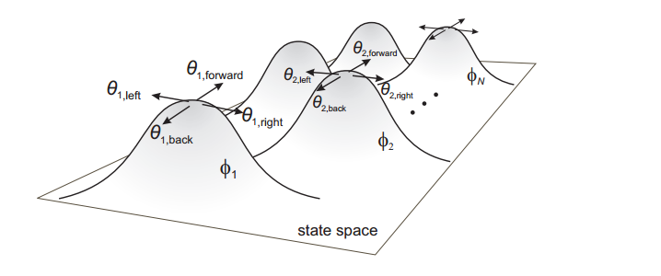
Dealing with the real world
In the real world, we cannot usually learn about every single state, or even action.
We can usually discretize action space, but state space is too high-dimensional.
We can use function approximation. This allows generalization.
Action discretization
State approximation

Slide 23
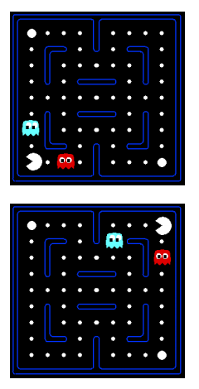
Dealing with the real world
Pacman has learned that (A) is bad. What about (B)?
We can describe a state using a vector of features f(s,a)
Distance to closest ghost, to closest dot
Number of ghosts
No. of action moves bringing Pacman closer to dots
...etc.
(A)
(B)

Slide 24
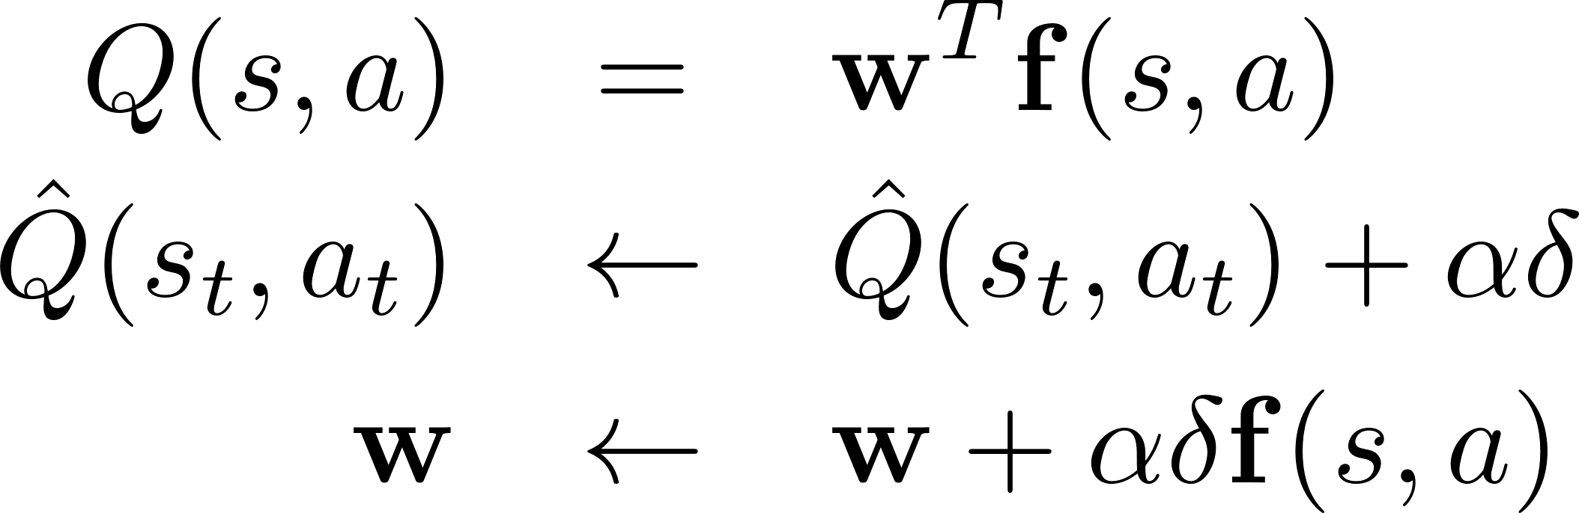
Function approximation
Use linear combination of features
This is equivalent to the update rule in online least-squares regression.
General supervised learning principle:
(A)
(B)

Slide 25
Thanks for your attention!

Slide 28
Jürgen Schmidhuber
First universal reinforcement learner for essentially arbitrary computable environments - the first optimal general rational agent.
This motivated the recent work on the Goedel machine for universal reinforcement learning with limited computational resources.
http://people.idsia.ch/~juergen/rl.html
Realistic environments are not fully observable. General learning agents need an internal state to memorize important events in case of POMDPs. The essential question is: how can they learn to identify and store those events relevant for further optimal action selection? Schmidhuber has studied reinforcement learners with recurrent neural network value function approximators.

Slide 29
Human-level control through deep RL
RL provides a normative account of optimal control.
It is deeply rooted in psychological & neuroscientific perspectives
How to derive efficient representations of the environment from high-dimensional sensory inputs?
How to generalize past experience to new situations?
Humans combine RL and hierarchical sensory processing
We want to use RL in combination with deep learning to build something like a deep Q-network (DQN, Mnih et al, Nature 2015). This principle draws on neurobiological evidence that reward signals during perceptual learning may influence the representations within primate visual cortex

Slide 30
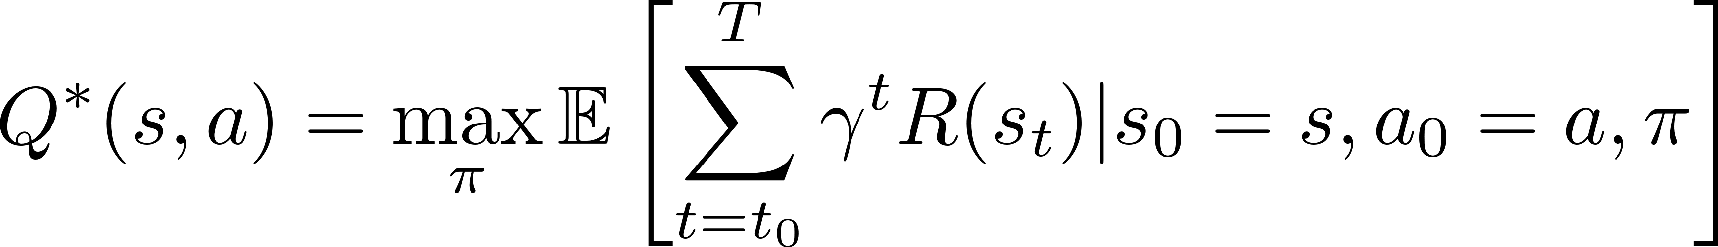
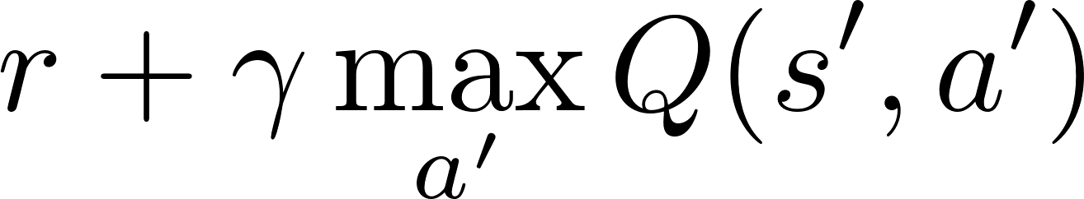
Human-level control through deep RL
Deep convolutional network: Hierarchical layers of tiled convolutional filters mimic the effects of receptive fields. This exploits the local spatial correlations present in images, and builds robustness to natural transformations such as changes of viewpoint or scale.
Approximate the optimal action-value function
But RL using nonlinear function approximations the Q-function is unstable. This is due to (i) correlations in the observations, (ii) the fact that small changes to Q may significantly change the policy and (iii) correlations between Q(s,a)-values and target values

Slide 31
A novel iterative update rule adjusts Q-values such that correlations with target values are reduced.
Use approximate value function Q(s,a;θ_{i}), where θ_{i} are the parameters of a deep convolutional neural network at iteration i

Slide 32
Experience replay randomizes over data. This removes correlations in the observation sequence and smoothes over changes in the data distribution. During learning, we sample uniformly from the set of the agent‘s experiences and apply Q-Learning to minibatches of experience e using the following loss function
Convergent evidence suggests that the hippocampus may support the physical realization of such a process in the brain, with the time-compressed reactivation of recently experienced trajectories during offline periods (for example, waking rest) providing a putative mechanism by which value functions may be efficiently updated through interactions with the basal ganglia.

Slide 33
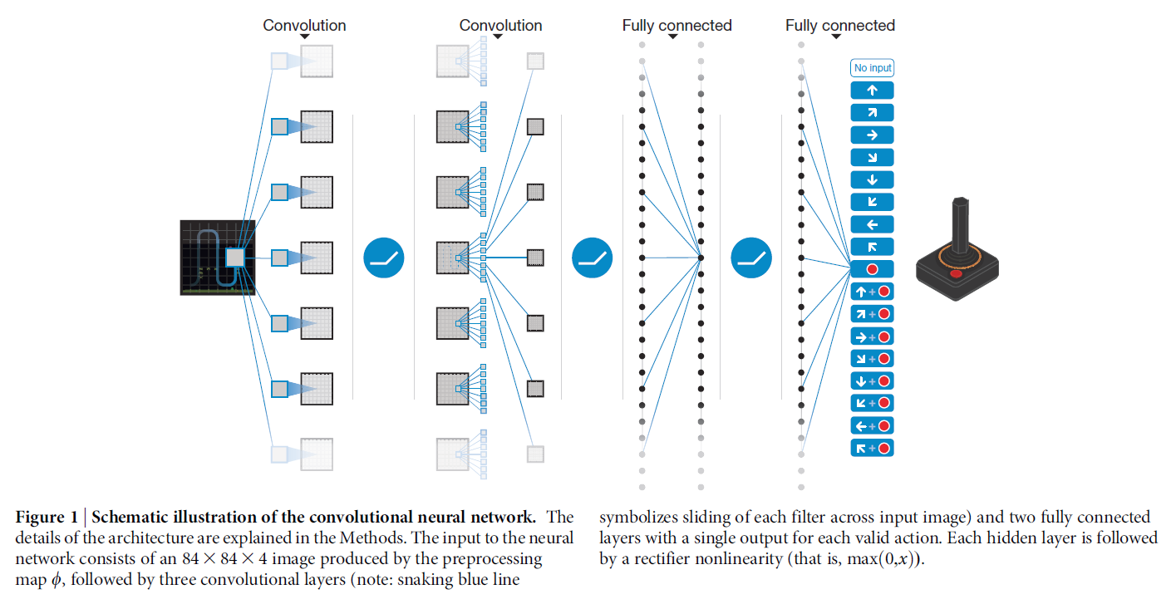
Mnih et al, Nature 2015

Slide 34
TODO
How to bias content of experience replay towards salient events? (in relation to prioritized sweeping in RL)
Jürgen Schmidhuber‘s opinion: http://people.idsia.ch/~juergen/naturedeepmind.html
DEMO: http://cs.stanford.edu/people/karpathy/convnetjs/demo/rldemo.html

